Slide 1
BATTLE OF NEIGHBORHOODS WEEK 1

Slide 2
INTRODUCTION
DELHI IS KNOWN as the food capital of India. The city is famous for a variety of foods, dishes, and restaurants. It was recently named “Best Destination For Food/Drink in India”.

Slide 3
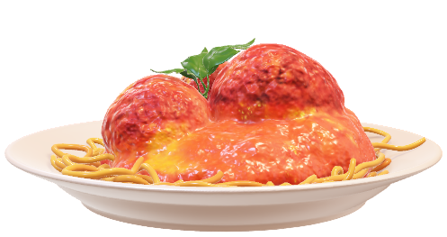
Business PROBLEM
As part of my ‘Applied Data Science Capstone’ final project, I shall survey the type of restaurants in different neighborhoods of Delhi to determine the most suitable place to open an Indian restaurant. The use of Data science techniques and machine learning algorithms such as Clustering, shall help us answer the above described business problem.

Slide 4
TARGET AUDIENCE
The target audience of the above business problem is a restauranteur who is looking for the right neighborhood to open an Indian restaurant.

Slide 5
DATA
To solve the above business problem, we shall need the following data:-
A list of neighborhoods in Delhi.
Latitude and Longitude data of neighborhoods-Latitude and longitude data could be extracted using the Geocoder package.
Venue-related data- Venue related data could be extracted using the Foursquare API.

